Slide 1
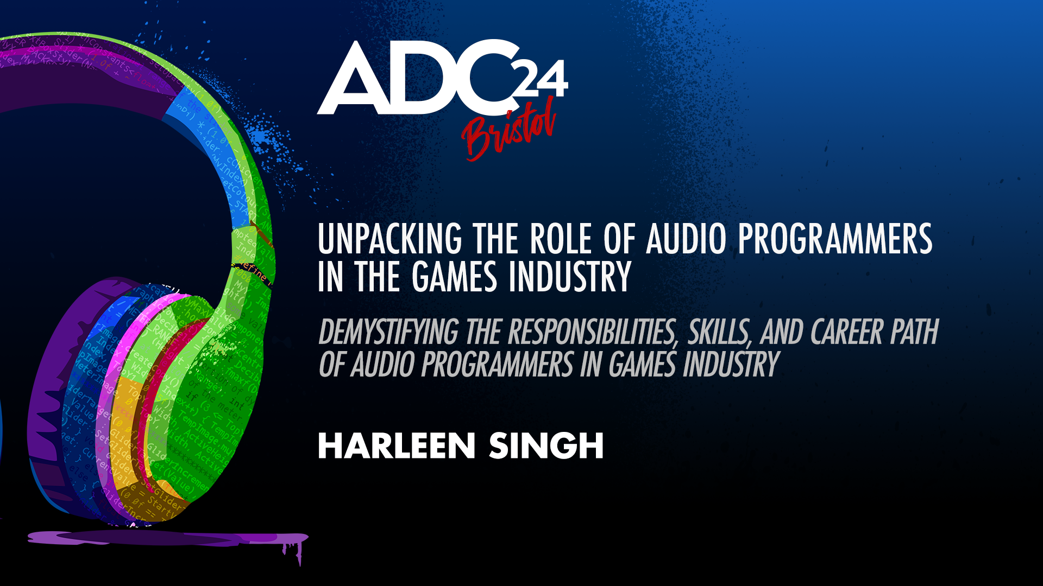
Notes:
Hello and welcome!

Slide 2
Who is this?

Slide 3
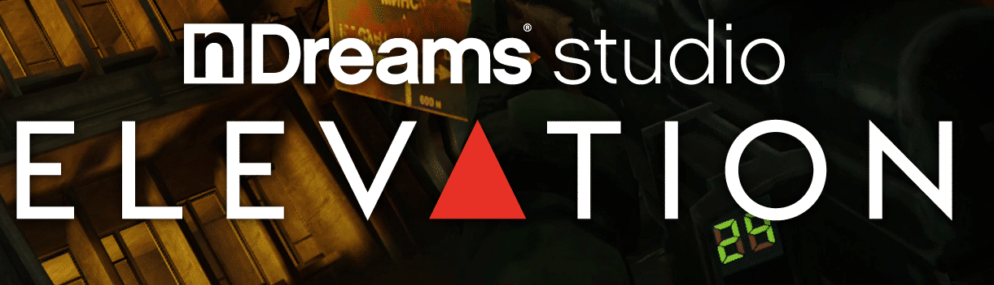

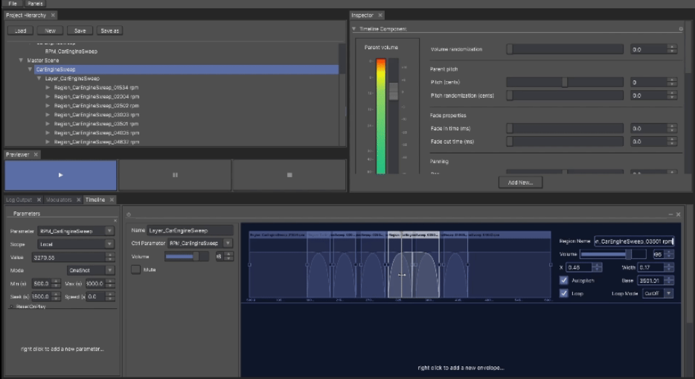

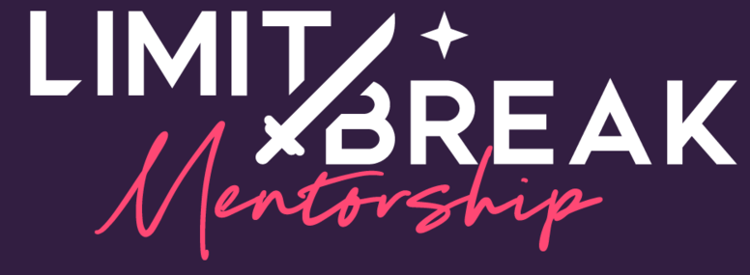
Harleen Singh
Audio Programmer: Game Audio Systems and Tools
Currently at nDreams Elevation: Action-Adventure VR
Previously Tazman-Audio
Limit Break Mentorship
Sharing insights based on my experience—still learning every day!

Slide 4
Why am I talking about this?
Notes:
Not well documented
I struggled at the beginning
Surprising
High demand
Becoming common even for small-mid sized studios
Lots of misconceptions regarding responsibilities

Slide 5
The Dream Job(?)
You wake up as someone who loves, audio, music, games and programming
You remember a job post for an audio programmer at your dream game company
You open your laptop to check it out… and then you see this:

Slide 6
Fictional Job Advert
Implement and optimise runtime audio systems using middleware and game engines
Develop tools and features for sound designers
Troubleshoot and resolve audio-related issues
Proficient in C++, Wwise/FMOD, Unreal/Unity/Custom engines, and scripting languages (Python/Lua)
Experienced with PC, console, and online multiplayer game development
Familiar with object-oriented programming (OOP) and multithreaded environments
Strong math skills (linear algebra, trigonometry)
Skilled in DSP and procedural audio techniques
Knowledgeable in ambisonics, HRTFs, and 3D spatialization concepts

Slide 7
And then you immediately shut your laptop
At least I did!

Slide 8
Reality Check
Take adverts with a grain of salt, they're often copy-pasted templates
You don’t need to know everything on the list, especially when starting
The role can vary by company and project
Let’s break it down into role specialisations for clarity

Slide 9
Common agreed upon breakdown
Audio Programmer
Engine/DSP Programmer
Tools Programmer
Systems Programmer

Slide 10
Engine and DSP Programming
Many game companies use off-the-shelf audio tools like Wwise, FMOD, and Fabric
These tools enable complex sound behaviours without code support
Larger companies may use proprietary engines or combine tools with in-house engines
Alternatively, you could work for an audio middleware provider
Core components include I/O, mixing, summing, and DSP (reverb, filtering, etc.)

Slide 11

Haptics
Feedback Mechanisms: Vibration/resistance (frequency, amplitude)
for weight and impact—e.g., pulling a bow string
Design Approach: Hand-designed?
Real-time Audio: Driven by mix buses
Offline Assets?
Multi-Platform Implications
Exposing Parameters: For easier game implementation
Notes:
Brief introduction of haptics
So now you have some foundational system that we need so sound designer can start making content and implementing it in the game, but this process can sometimes be very slow or repetitive

Slide 12
What next?
Core audio systems enable sound designers to bring content into the game
Asset implementation is time-consuming
Off-the-shelf tools are often general-purpose, sometimes requiring custom tools to meet specific needs

Slide 13
Tools Programmer
Analyse workflows and gather feedback from designers
Optimise workflows for efficiency
Experience with audio content creation tools
More common in larger studios
Example time!

Slide 14
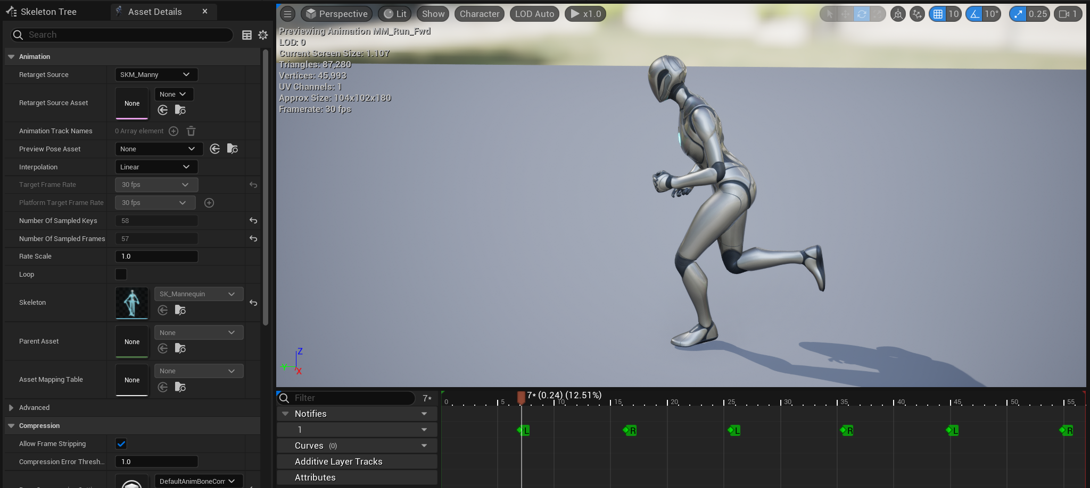
Animation-Driven Audio
Example: Footsteps
Usual workflow:
Find animation in the editor
Add notifier
Assign audio events
Initialise properties

Slide 15
When this is not doable
Scalability: Manually adding notifiers is impractical for large projects
Consistency: Hard to maintain uniformity across assets
Error-Prone: Increases risk of mistakes
Maintenance: Requires ongoing updates as projects evolve

Slide 16
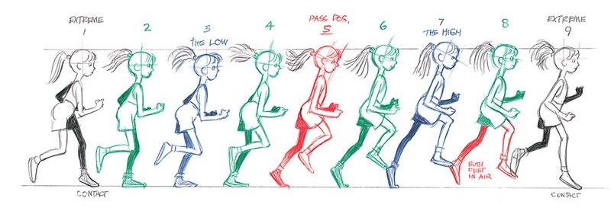
What can we do about it?
Offline Analysis: Place animation notifiers automatically
Track bone position, angle, velocity
Perform stride analysis
Identify traversal types (walk, run, climb)
Result: Frees up sound designers for more creative work!
Image from The Animator's Survival Kit by Richard Williams
Notes:
Now we have got foundational Audio Engine and DSP related work done
We have created nice tooling so sound designers can work efficiently
Behind the scenes, there are a lot of complex audio systems that dictate how sounds and music behave in a dynamic world

Slide 17
Nice foundation, good tools, so we are done, right?
Not Quite Done Yet: Last piece of the puzzle, is runtime systems catered to the game
Bringing Audio to Life in Real Time: Respond to Dynamic gameplay and provide spatial cues

Slide 18
Audio Systems Programmer
Cross-Disciplinary: Collaborate with teams on runtime audio systems
Game-Specific Focus: Tailor audio solutions to the game
Align sound and music systems with the game’s narrative vision
Resource Management: Keep audio within CPU and memory limits
Example time!

Slide 19
Sound Propagation
Exploring how sound travels and responds to the environment
Various methods exist to achieve these effects
Let’s explore a simplified approach to this complex topic
Notes:
One of my favourite topics
Programmer art

Slide 20
Sound Propagation
Occlusion: Traces from the emitter, loss of energy
Diffraction: Pathfinding and filtering, bending of sound
Reflections: Listener traces to estimate points
Late Reverb
Physical Materials
Manual volume and portal placement
Acoustic Graphs: For automation
Direct Sound
Indirect Sound
Room 1
Room 2

Slide 21
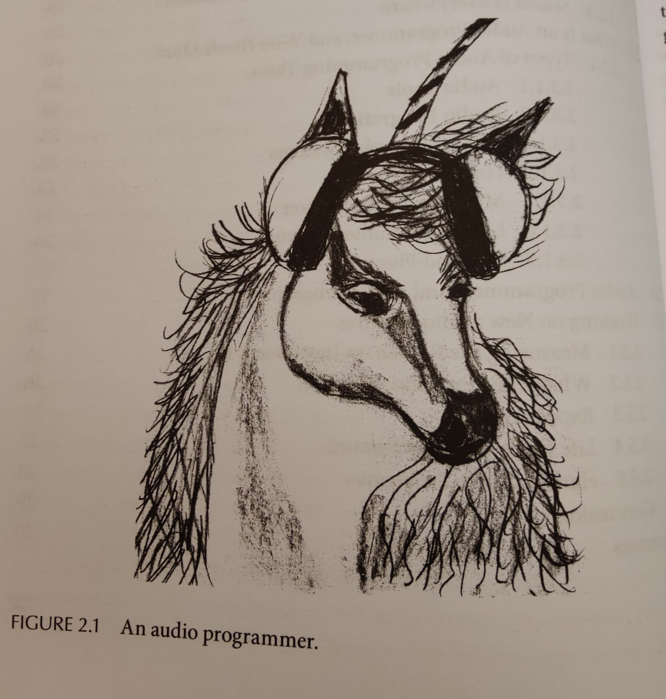
What to expect!
Job ads can feel overwhelming—don’t hesitate to ask for clarity, game
audio folks are very approachable
Unicorns (experts who do it all) are hard to find, but they do exist
A lot of roles focus on audio systems programming
What if your focus is on DSP and engine programming?
Tools roles follow a similar path
There are some overlaps in skills and qualities
Beauchemin, S. (2019)
Notes:
"So now that we've explored the different roles, here’s something important to keep in mind: most people starting out in audio programming come in with strong knowledge in one specific area. Whether it’s tools, systems, or DSP, having solid fundamentals in just one area is a great start. The rest? That can often be learned on the job.
I can confirm this is what a peak audio programmer looks like

Slide 22
Key Skills and Qualities
Unique Cross-department collaboration with teams like Physics, AI, and Animation
Resource optimisation within typical 10% audio budget
Fundamental understanding of any game and audio engine
Ability to evaluate effective audio in games with some experience with content creation
Supporting sound designers’ creative vision
At a game studio, the goal is a great-sounding game—players won’t see the underlying
implementation, unlike in commercial tool development
Notes:
That’s all cool, but where can I learn all of this?

Slide 23
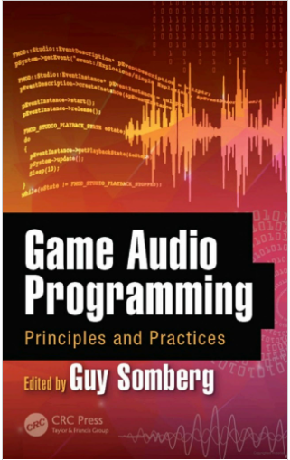
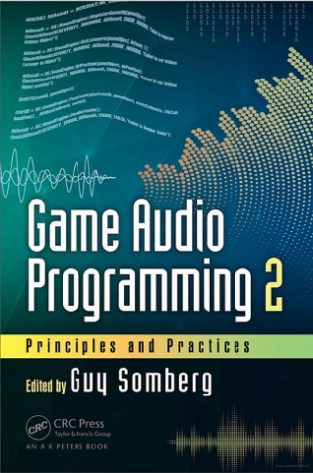
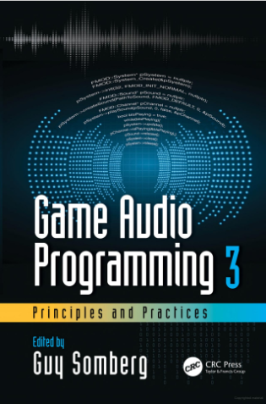
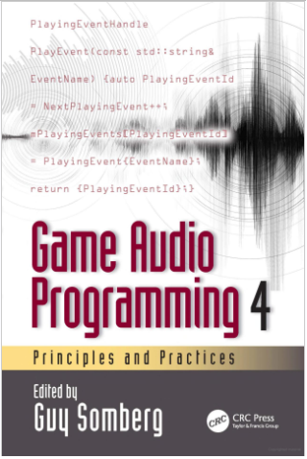
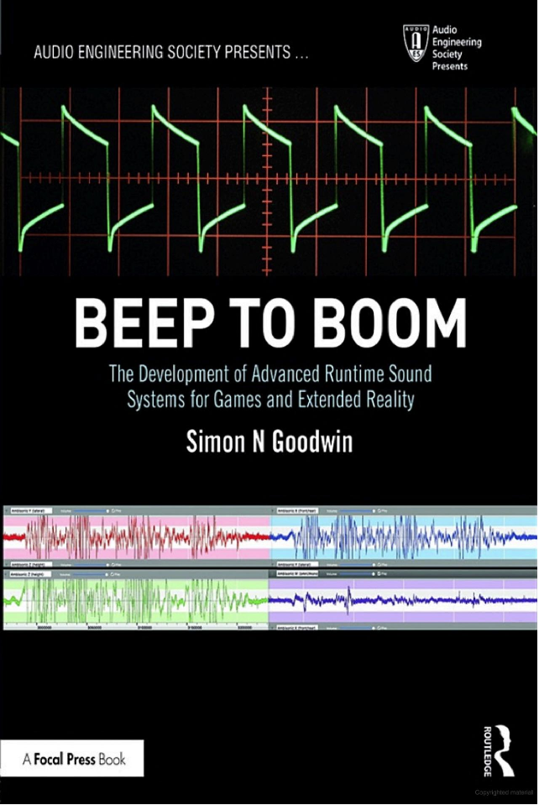
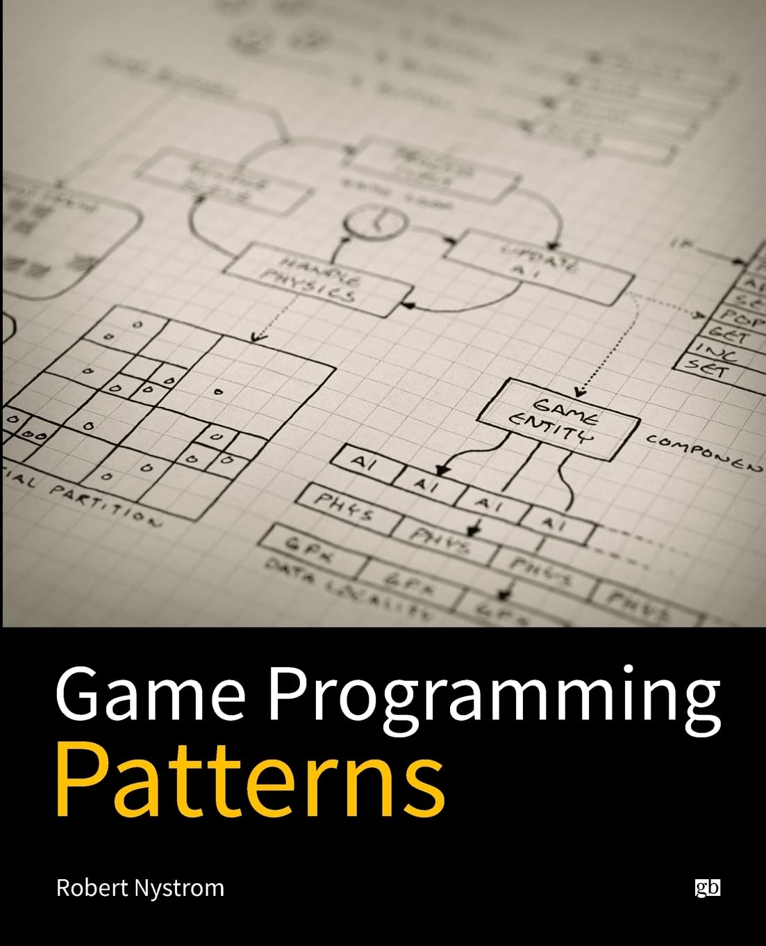
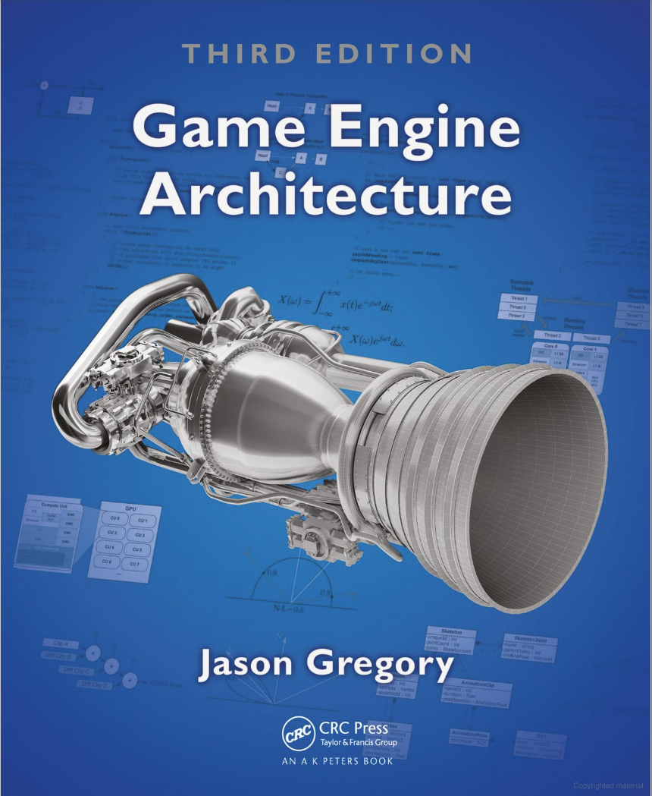
That sounds cool, where can I learn more?
Some nice books:
Game Audio Programming Books (Covers a bit of all three pillars)
Beep To Boom (Runtime Audio Systems)
Game Programming Patterns (Web version free)
Game Engine Architecture (Includes chapters on systems, rendering, animation , audio etc.)

Slide 24
Good Platforms
GDC Vault - https://gdcvault.com/free
Autokinetic Blogs - https://www.audiokinetic.com/en/blog/
Unreal Engine Youtube Channel - https://www.youtube.com/@UnrealEngine/videos
ADC Youtube Channel - https://www.youtube.com/@audiodevcon
More on my page

Slide 25
References
Beauchemin, S. (2019). A Rare Breed: The Audio Programmer. In G. Somberg (Ed.), Game Audio Programming 2: Principles and Practices. CRC Press.
Williams, Richard. The Animator's Survival Kit. Expanded Ed., Faber & Faber, 2009.

Slide 26

Thank you!
harleensound@gmail.com
www.linkedin.com/in/harleen-s-dev
https://github.com/singhHarleen/ADC2024
https://singhharleen.github.io/learning-resources.html
Learning Resources

